Slide 1
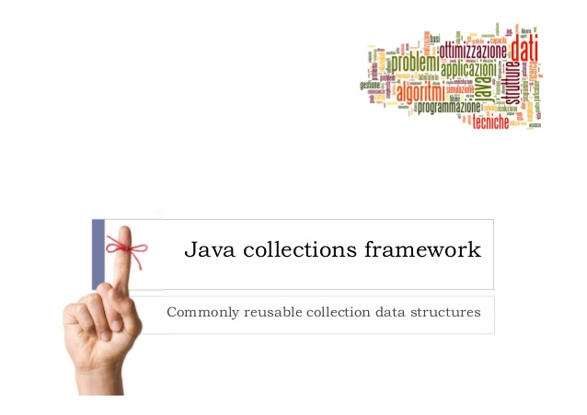
exceptions

Slide 2
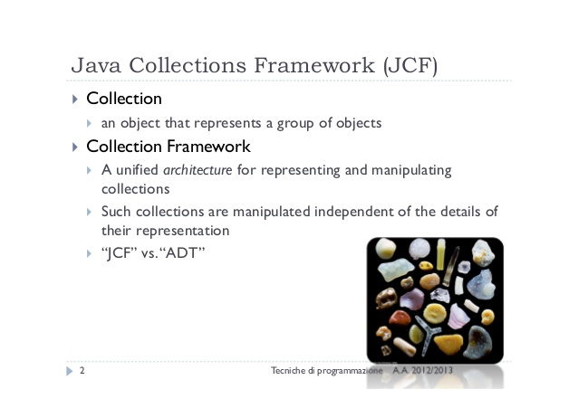
exceptions

Slide 3
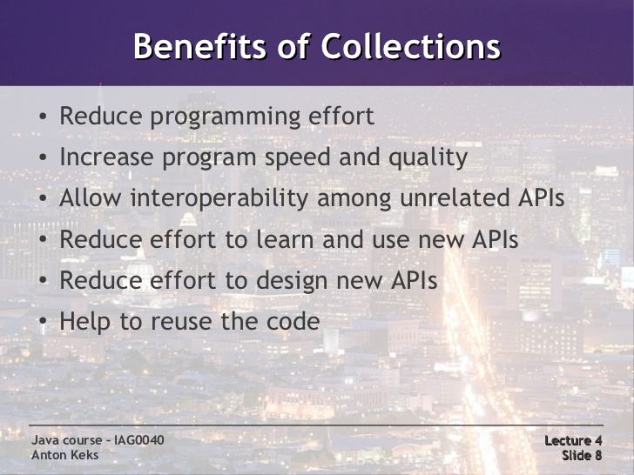
exceptions

Slide 4
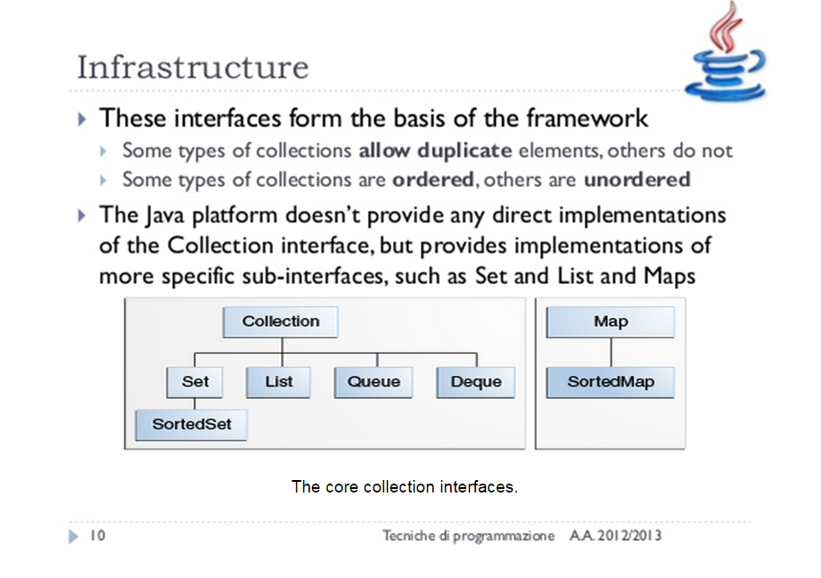
exceptions

Slide 5
exceptions
All permit null elements, keys, and values.
None are synchronized (thread-safe).
All have fail-fast iterators.
All are Serializable and all support a public clone method

Slide 6
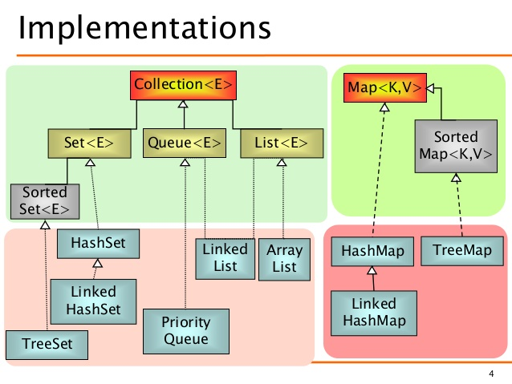
exceptions

Slide 7
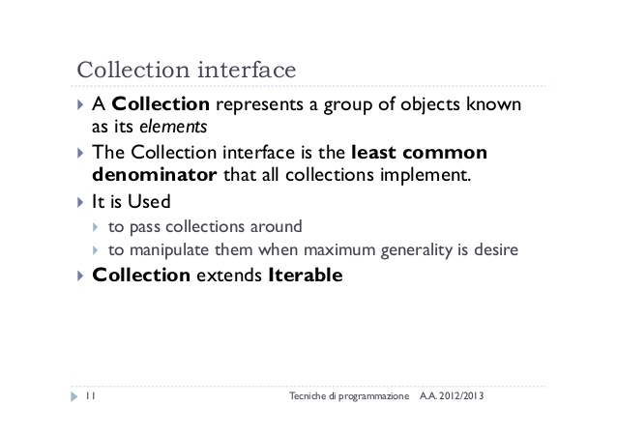
exceptions

Slide 8
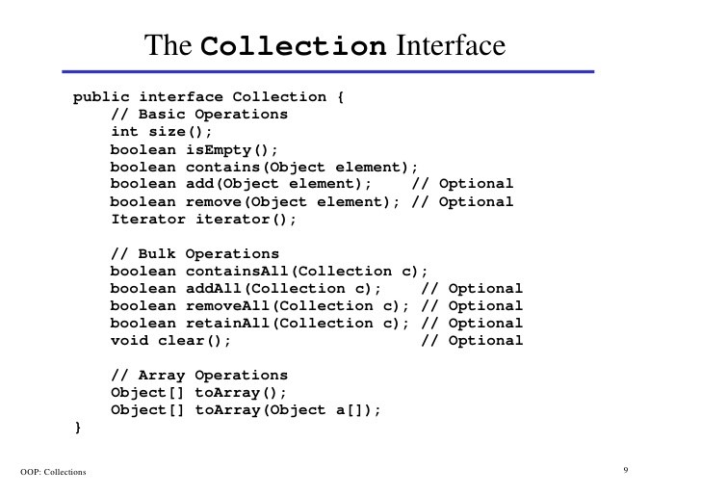
inheritance

Slide 9
inheritance
Traversing Collections
Using for-each construct:
class ForDemo {
public static void main(String[] args){
for(int i=1; i<11; i++){
System.out.println("Count is: " + i);
}
}
}
Using Iterators
static void filter(Collection<?> c) {
for (Iterator<?> it = c.iterator(); it.hasNext(); )
if (!cond(it.next()))
it.remove();
}
Enhanced for loop
class ForDemo {
public static void main(String[] args){
for(int i;args){
System.out.println("Count is: " + i);
}
}
}
Aggregate Operations
myShapesCollection.stream()
.filter(e -> e.getColor() == Color.RED)
.forEach(e -> System.out.println(e.getName()));

Slide 10
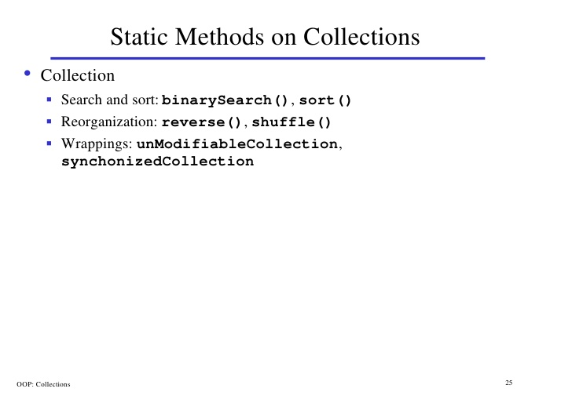
inheritance

Slide 11
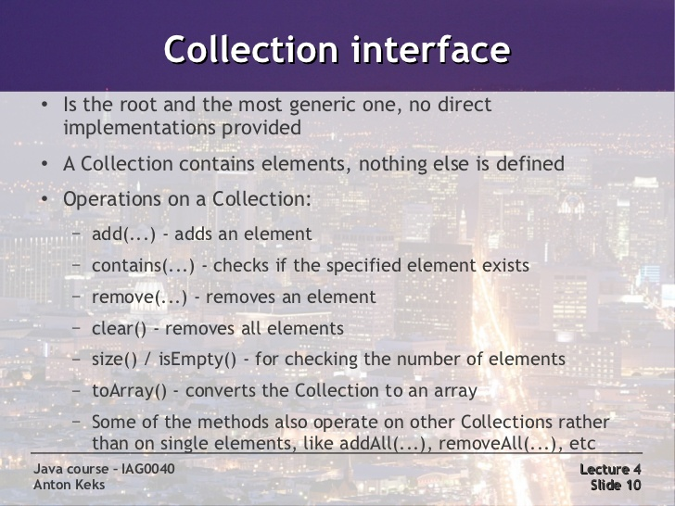
exceptions

Slide 12
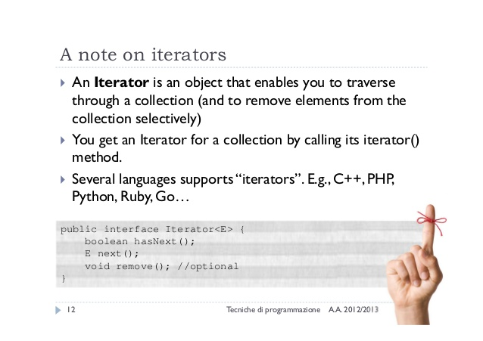
exceptions

Slide 13
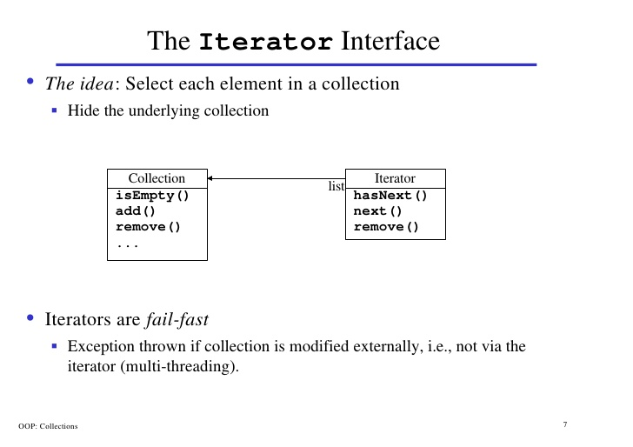
inheritance

Slide 14
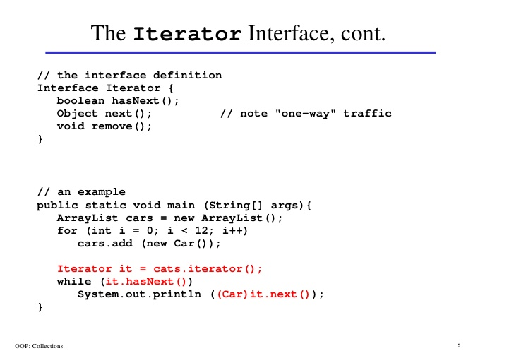
inheritance

Slide 15
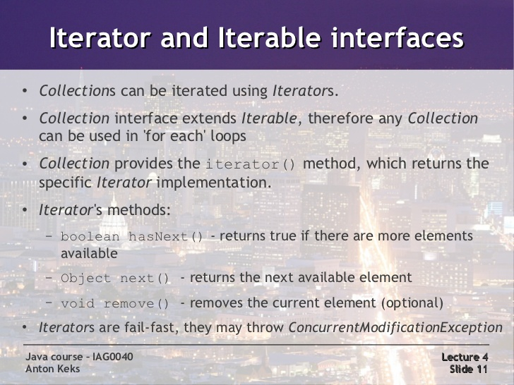
exceptions

Slide 16
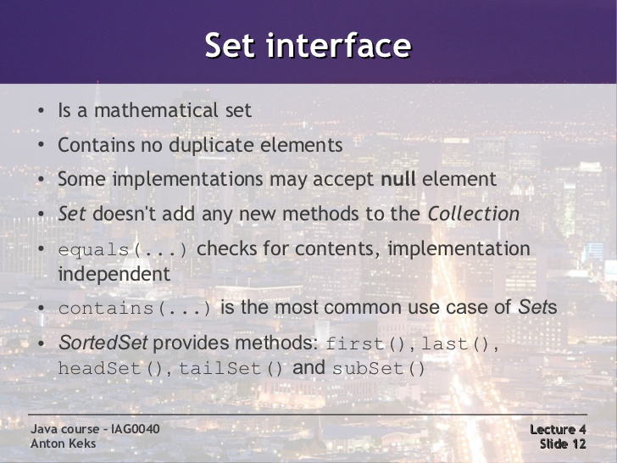
exceptions
Lab15.1: Demonstration of traversing through sets.
Lab15.2: Demonstration of traversing through sets using iterator
Lab15.3: Demonstration of traversing through sets:

Slide 17
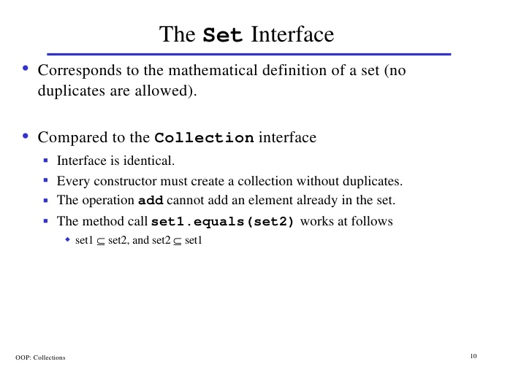
inheritance

Slide 18
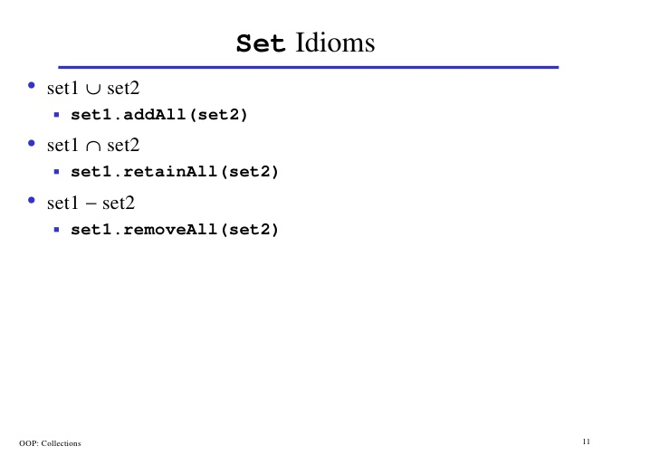
inheritance

Slide 19
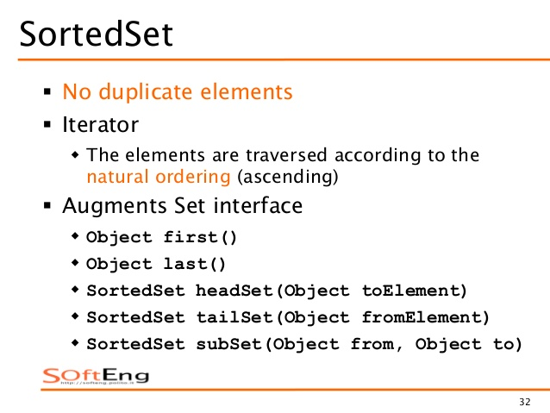
inheritance

Slide 20
exceptions
Set Implementations
General Purpose
HashSet
Faster than TreeSet
No ordering of the elements
TreeSet
Use when the ordering of the elements is important
LinkedHashSet
Implemented as a HashTable with a linked list running through it.
Intermediate between HashSet and TreeSet.
Special Purpose
EnumSet
EnumSet is a high-performance Set implementation for enum types.
CopyOnWriteArraySet
It is a Set implementation backed up by a copy-on-write array.
Only appropriate for sets that are rarely modified but frequently iterated.
It is thread safe.

Slide 21
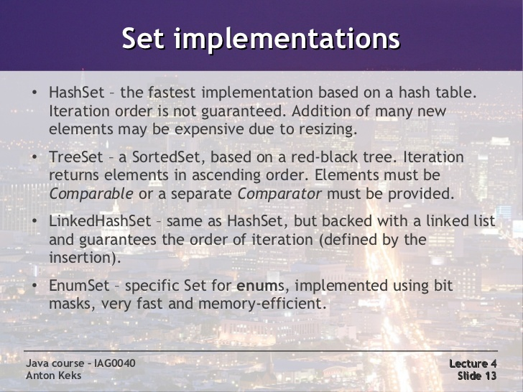
exceptions

Slide 22
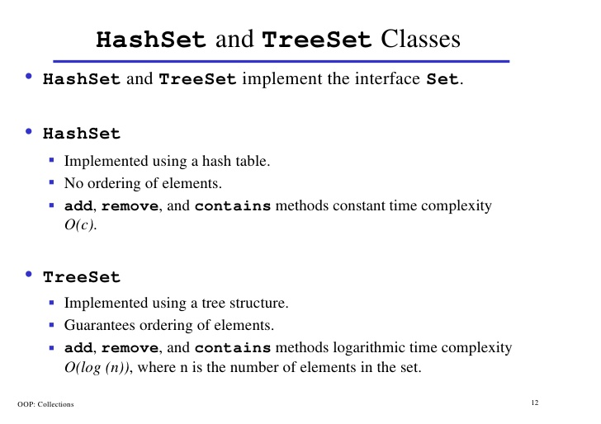
inheritance

Slide 23
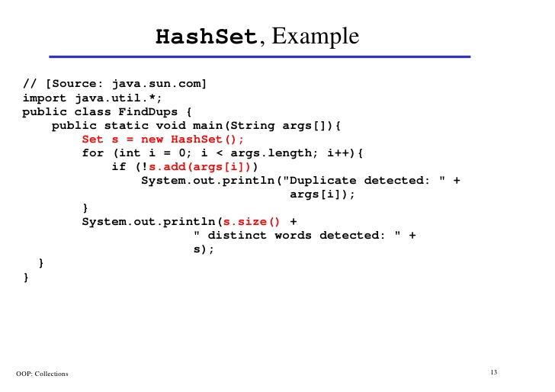
inheritance

Slide 24
exceptions
Set Implementations : EnumSet
EnumSet is a high-performance Set implementation for enum types.
All of the members of an enum set must be of the same enum type.
Enum sets support iteration over ranges of enum types.
Ex:
EnumSet<Color> white = EnumSet.of(Color.RED, Color.GREEN, Color.BLUE);
Lab15.31: Demonstration of working with EnumSet

Slide 25
exceptions
Set Implementations : CopyOnWriteArraySet
CopyOnWriteArraySet is a Set implementation backed up by a copy-on-write array.
Suitable for sharing the data structure among several threads and have few writes and many reads.
It is thread-safe.
Mutative operations (add, set, remove, etc.) are expensive since they usually entail copying the entire underlying array.
Traversal via iterators is
Iterators rely on unchanging snapshots of the array at the time the iterators were constructed.
Iterator uses a snapshot of the underlying list (or set) and does not reflect any changes to the list or set after the snapshot was created.

Slide 26
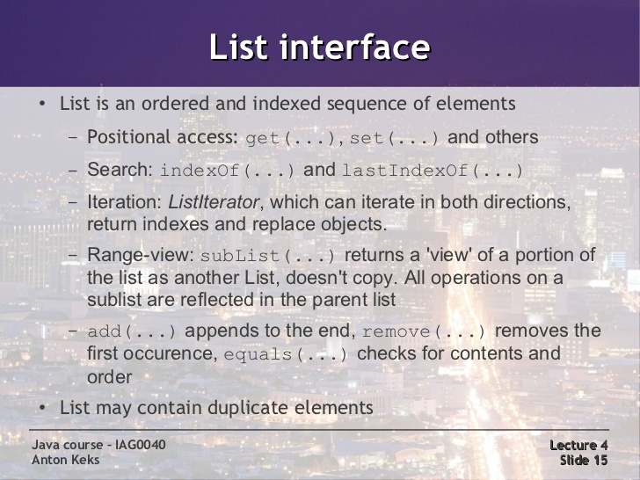
exceptions
Lab15.4: Demonstration of traversing through list:

Slide 27
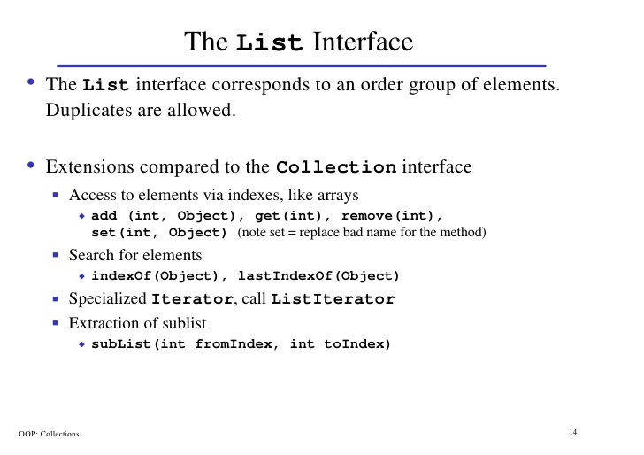
inheritance

Slide 28
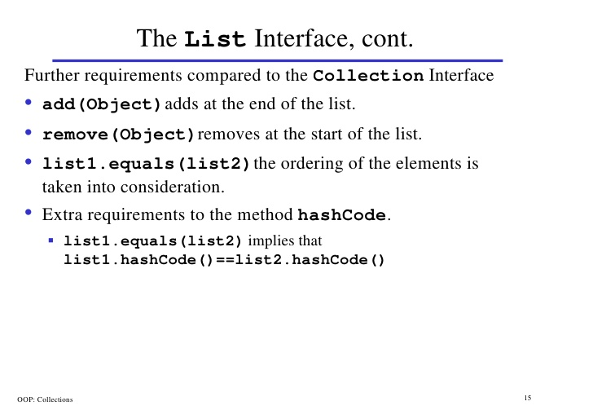
inheritance

Slide 29
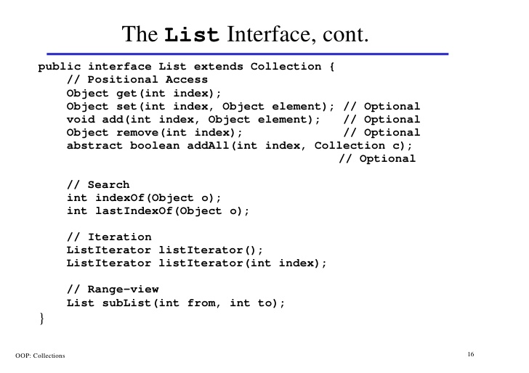
inheritance

Slide 30
exceptions
List Implementations
General Purpose Implementations
ArrayList
Resizable-array implementation of the List interface.
Supports positional access.
Not thread safe
Suitable for adding/removing elements to the end of the list
Suitable for getting the elements by specifying index.
LinkedList
Use when you want to add/delete item from the beginning or middle of the list .
Memory consumption is high compared to ArrayList.
Special Purpose Implementations
CopyOnWriteArrayList
It is a List implementation backed up by a copy-on-write array.
Thread Safe.
Suitable where there is minimal write and more read.

Slide 31
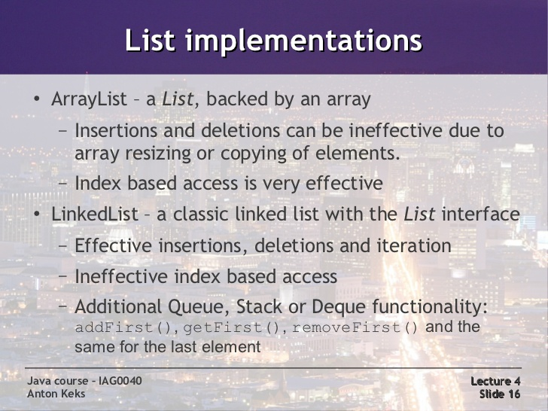
exceptions

Slide 32
inheritance
Collections API
This class consists exclusively of static methods that operate on or return collections. It contains polymorphic algorithms that operate on collections

Slide 33
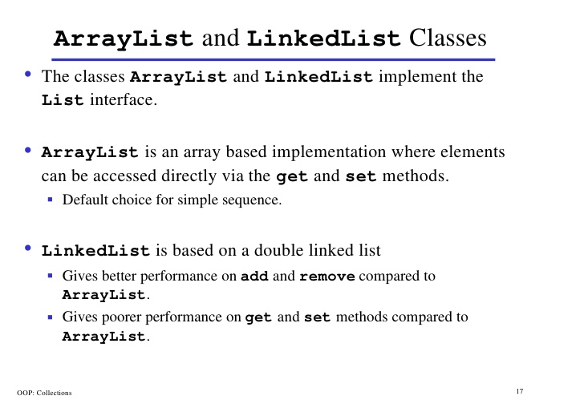
inheritance
Lab15.5: Demonstration of working with List using card game:

Slide 34
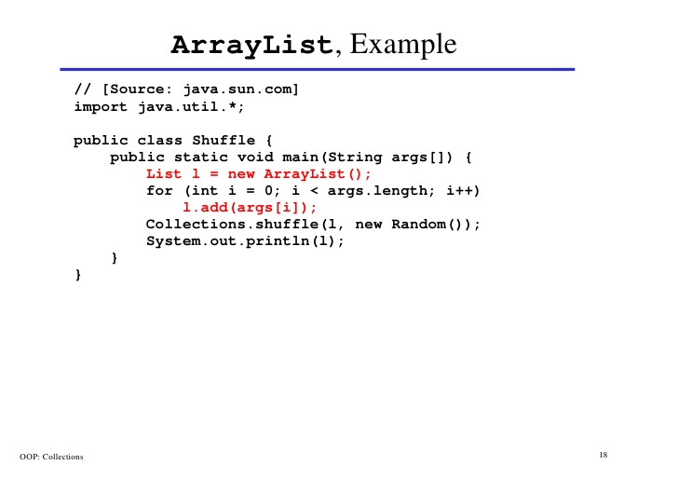
inheritance

Slide 35
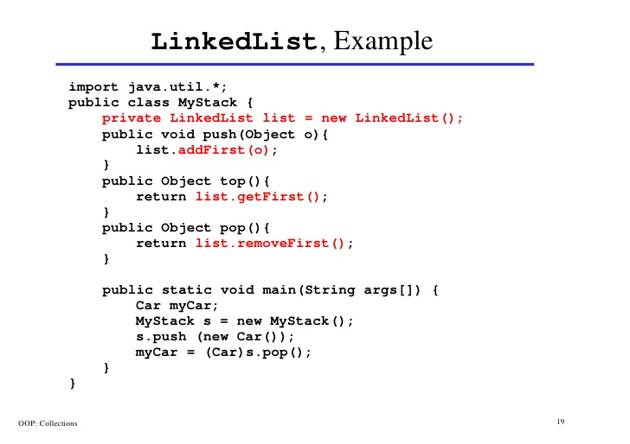
inheritance

Slide 36
exceptions
List Implementations : CopyOnWriteArrayList
CopyOnWriteArrayList is a list implementation backed up by a copy-on-write array.
Suitable for sharing the data structure among several threads and have few writes and many reads.
It is thread-safe.
Mutative operations (add, set, remove, etc.) are expensive since they usually entail copying the entire underlying array.
Traversal via iterators.
Iterators rely on unchanging snapshots of the array at the time the iterators were constructed.
Iterator uses a snapshot of the underlying list (or set) and does not reflect any changes to the list or set after the snapshot was created.

Slide 37
exceptions
Similarities between ArrayList and HashSet
Both ArrayList and HashSet are non synchronized.
You can make ArrayList and HashSet synchronized by using Collections.synchroinzedCollection().
Both ArrayList and HashSet can be traversed using Iterator.
Iterator of ArrayList and HashSet both are fail-fast, i.e. they will throw ConcurrentModificationException if ArrayList or HashSet is modified structurally once Iterator has been created.

Slide 38
exceptions
Differences between ArrayList and HashSet
ArrayList | HashSet
Implements List interface | Implements Set interface
Allows duplicates | Doesn't allow duplicates
Ordered collection that maintains insertion order | Doesn't maintain the insertion order
Backed by Array | Backed by Hash table
Index based you can retrieve object by calling get(index) or remove objects by calling remove(index) | Object based. HashSet also doesn't provide get() method.

Slide 39
exceptions
Similarities between ArrayList and LinkedList
Both ArrayList and LinkedList implements List interface.
Both maintains the element insertion order.
Both these classes are not synchronized (not thread safe)
The iterator and listIterator returned by these classes are fail-fast.

Slide 40
exceptions
Differences between ArrayList and LinkedList
ArrayList | LinkedList
Search Operations is fast as it uses array data structure. | Search operation is slow as search requires traversing through all the elements of the list.
Deleting elements from the beginning and middle of the list is slow. | Deletion is fast.
Insertion of new element is slow | Insertion is fast.
Memory consumption is low. | Memory consumption is high as it needs to maintain two pointers for each element.
 | LinkedList also implements the Queue interface.

Slide 41
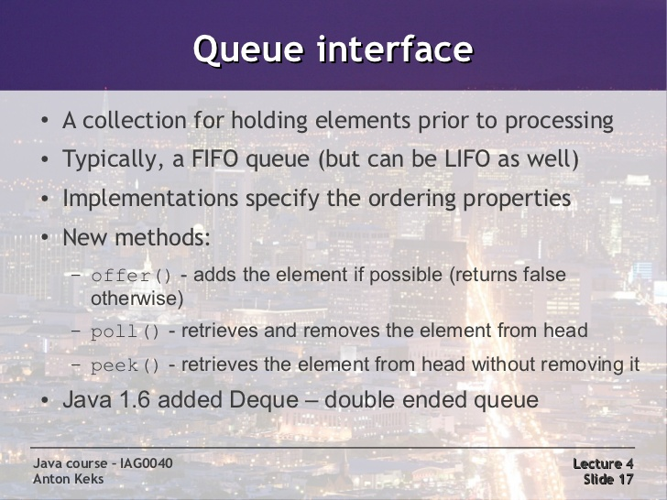
exceptions

Slide 42
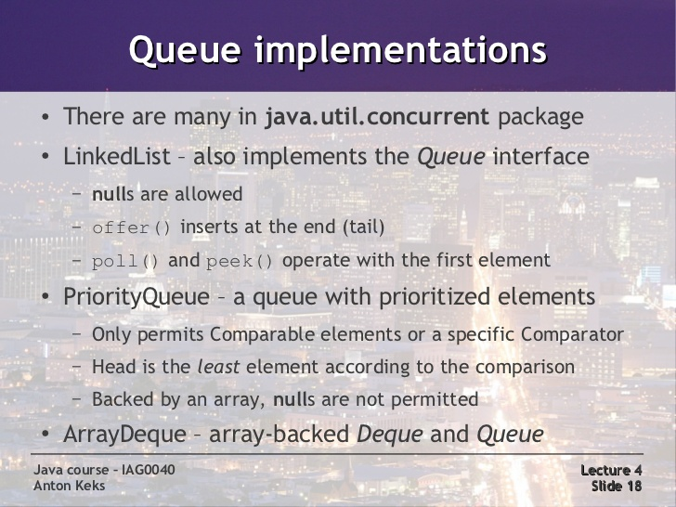
exceptions
Lab15.6: Demonstration of working with Queue with countdown example

Slide 43
exceptions
Deque
linear collection of elements that supports the insertion and removal of elements at both end points.
Defines methods for accessing the elements from both ends of the queue.
Implementations: ArrayDeque and LinkedList

Slide 44
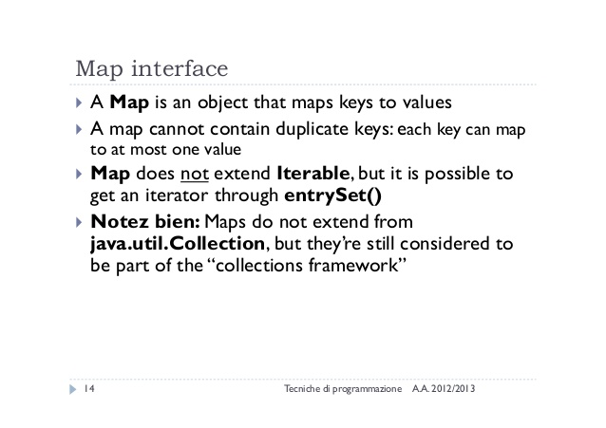
exceptions

Slide 45
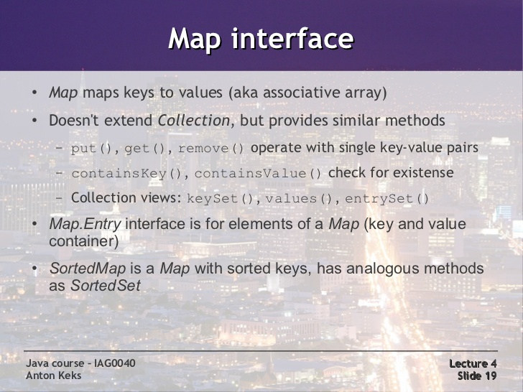
exceptions
Lab15.7: Demonstration of working with Maps:

Slide 46
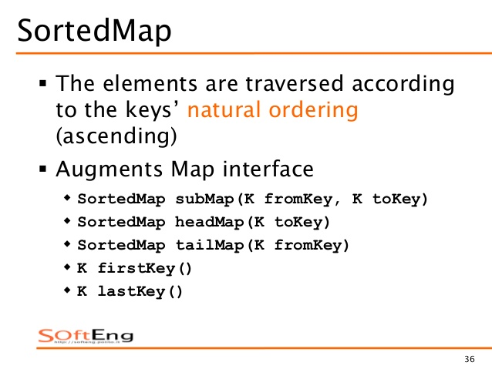
exceptions

Slide 47
exceptions
Map Implementations TODO
General Purpose Implementations
HashMap
Use when you want maximum speed and iteration order not necessary.
TreeMap
Use when iteration order is important.
LinkedHashMap
Use when you want to maintain the insertion order.
Special Purpose Map implementations
EnumMap
WeakHashMap
IdentityHashMap
ConcurrentHashMap

Slide 48
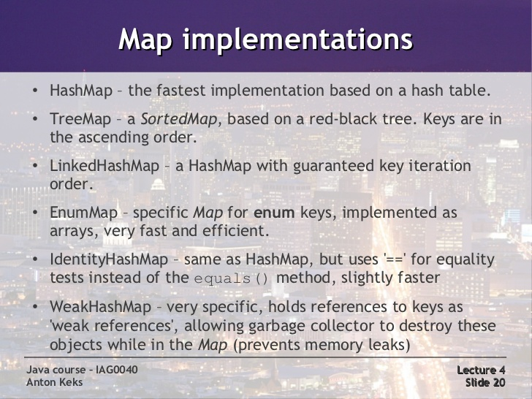
exceptions
Lab15.8: Demonstration of working with Maps with Anagram example:

Slide 49
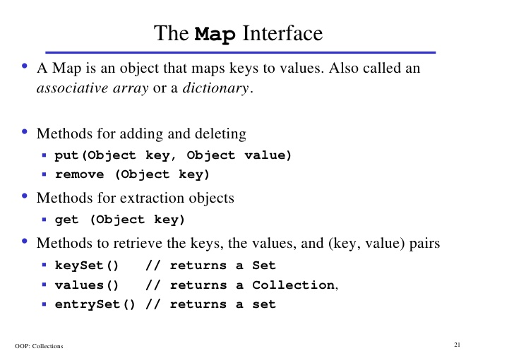
inheritance

Slide 50
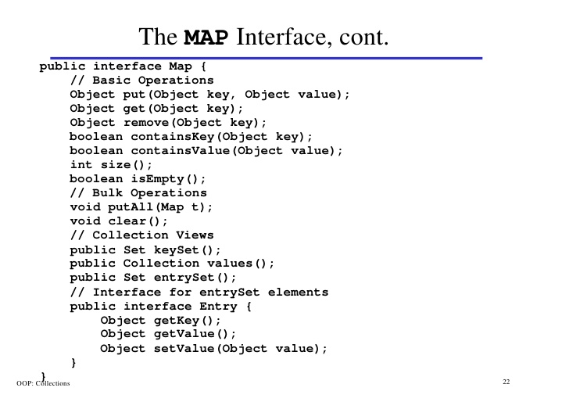
inheritance

Slide 51
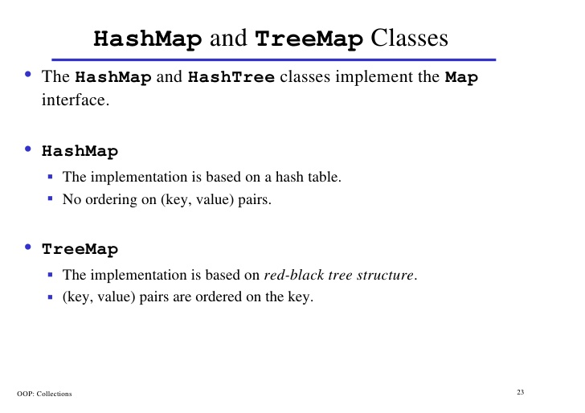
inheritance

Slide 52
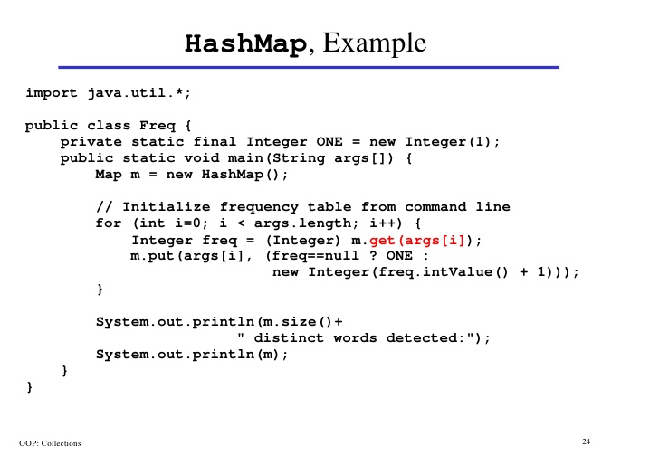
inheritance

Slide 53
exceptions
Map Implementations : LinkedHashMap
Use when insertion order is important.
We can create a linked hash map whose order of iteration is the order in which its entries were last accessed. This kind of map is well-suited to building LRU caches.
removeEldestEntry() method may be overridden to impose a policy for removing stale mappings automatically when new mappings are added to the map.

Slide 54
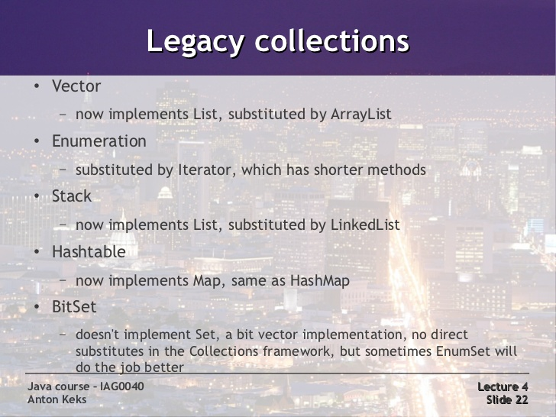
exceptions

Slide 55
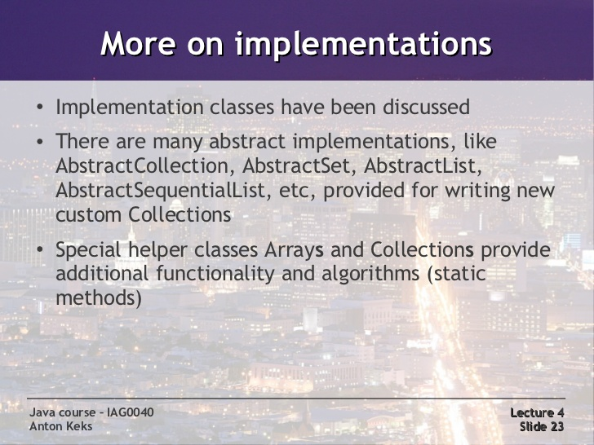
exceptions

Slide 56
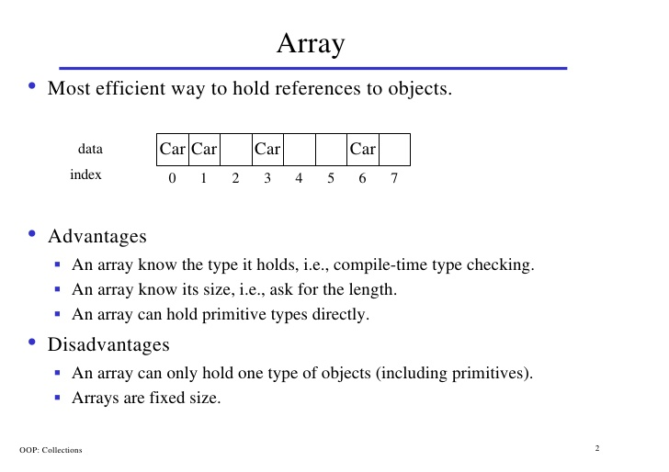
inheritance

Slide 57
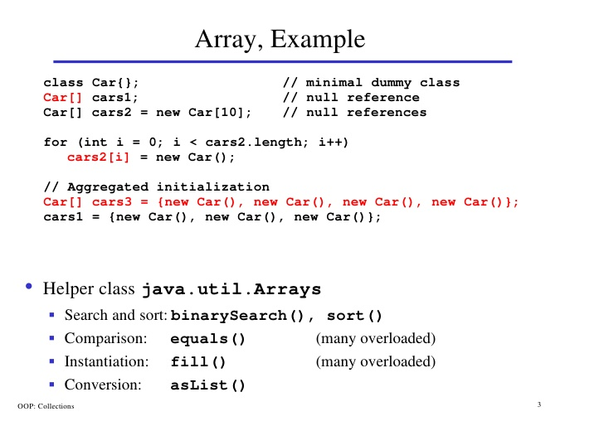
inheritance

Slide 58
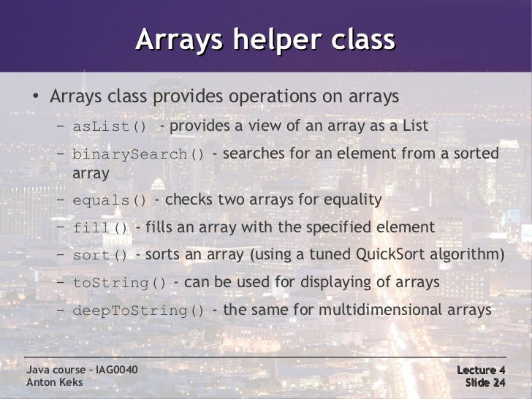
exceptions

Slide 59
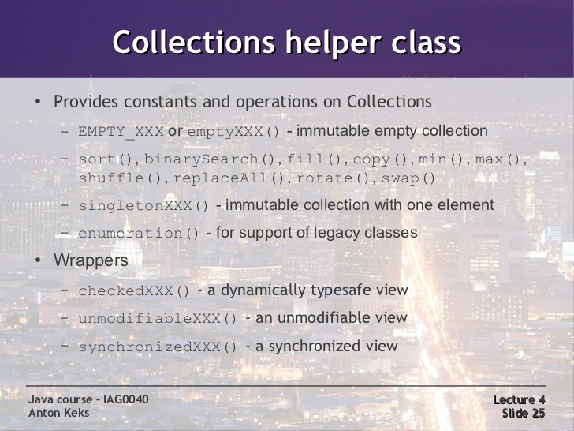
exceptions

Slide 60
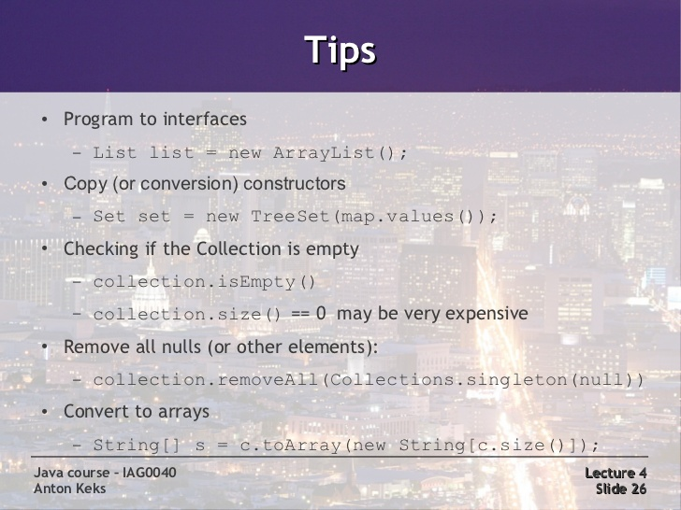
exceptions

Slide 61
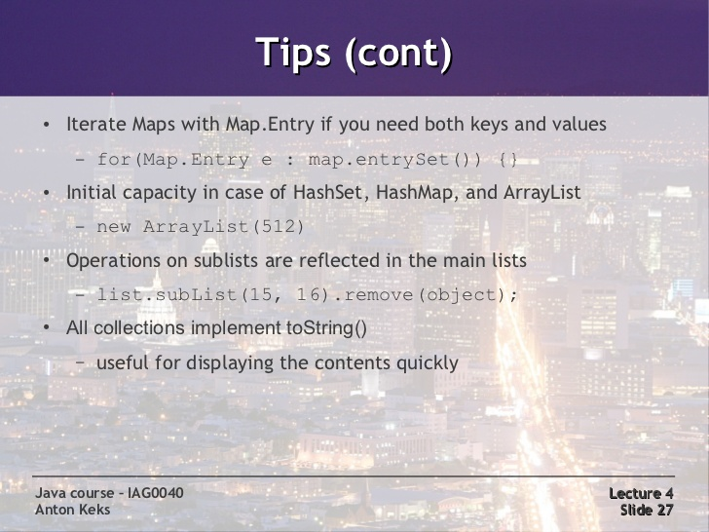
exceptions

Slide 62
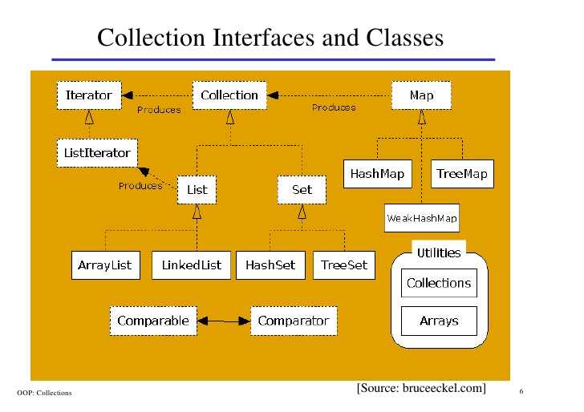
inheritance

Slide 63
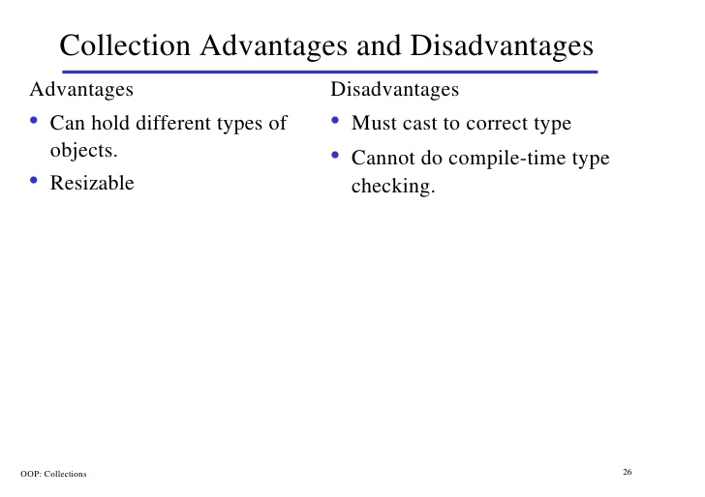
inheritance

Slide 64
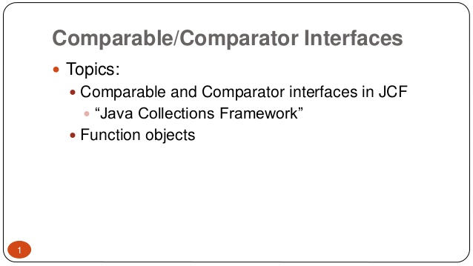
exceptions

Slide 65
exceptions

Slide 66
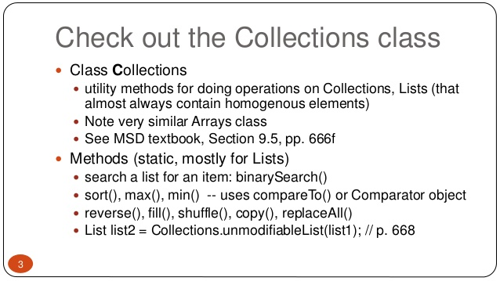
exceptions

Slide 67

exceptions

Slide 68

exceptions
Lab15.9: Demonstration of Comparing objects using Comparable interface:

Slide 69

exceptions

Slide 70

exceptions

Slide 71

exceptions

Slide 72

exceptions

Slide 73
exceptions

Slide 74

exceptions
Lab15.10: Demonstration of Comparing objects using Comparator:

Slide 75
exceptions

Slide 76
exceptions

Slide 77
exceptions

Slide 78
exceptions

Slide 79
exceptions

Slide 80
exceptions

Slide 81
exceptions

Slide 82
exceptions
Collections – A container is an object that groups multiple elemen its together in a single unit.
Used to store, retrieve, manipulate and communicate aggregate data.

Slide 83

inheritance

Slide 84
inheritance

Slide 85
inheritance

Slide 86
inheritance

Slide 87
inheritance

Slide 88
inheritance

Slide 89


inheritance

Slide 90
Interfaces and inheritance

Slide 91
Java - miscellaneous
Type Comparison Operator instanceof
The instanceof operator compares an object to a specified type.
You can use it to test if an object is an instance of a class, an instance of a subclass, or an instance of a class that implements a particular interface
Classes implementing interfaces
class MyClass extends MySuperClass implements YourInterface {
// field, constructor, and
// method declarations
}

Slide 92
Java - miscellaneous
Varargs – Specifying Arbitrary number of arguments
public Polygon polygonFrom(Point... corners) {
int numberOfSides = corners.length;
double squareOfSide1, lengthOfSide1;
squareOfSide1 = (corners[1].x - corners[0].x)
* (corners[1].x - corners[0].x)
+ (corners[1].y - corners[0].y)
* (corners[1].y - corners[0].y);
lengthOfSide1 = Math.sqrt(squareOfSide1);
// more method body code follows that creates and returns a
// polygon connecting the Points
}
You will most commonly see varargs with the printing methods; for example, this printf method:
public PrintStream printf(String format, Object... args)
allows you to print an arbitrary number of objects. It can be called like this:
System.out.printf("%s: %d, %s%n", name, idnum, address);

Slide 93

Java - miscellaneous
Returning a Class or Interface
When a method uses a class name as its return type the class of the type of the returned object must be either a subclass of, or the exact class of, the return type.
public Number returnANumber() {
...
}
The returnANumber method can return an ImaginaryNumber but not an Object. ImaginaryNumber is a Number because it's a subclass of Number. However, an Object is not necessarily a Number — it could be a String or another type

Slide 94
Advanced java
Garbage collection
JDBC
Lambda expressions
Annotations
Aggregate operations on collection using Lambarda expression.
Java streaming
Blocking queue
Aggregate operations

Slide 95
https://docs.oracle.com/javase/tutorial/reallybigindex.html
http://www.slideshare.net/EdurekaIN/java-class-3
http://www.slideshare.net/abdurrehmanabdurrehman391/variables-and-data-types-by-sir-khalid
http://www.slideshare.net/abdurrehmanabdurrehman391/java-advancedoop
http://www.slideshare.net/MindfireSolutions/java-garbage-collection-how-it-works?next_slideshow=1
http://www.slideshare.net/arnold7490/unit-4-java
http://www.slideshare.net/arnold7490/unit-3-java?next_slideshow=1
http://www.slideshare.net/tushardesarda/java-tutorial-3
http://www.slideshare.net/muralidhar9e/java-exception-handling-ppt
http://www.slideshare.net/emprovise/2-javabasics
http://www.slideshare.net/AllanHuang/java-new-evolution
http://www.slideshare.net/antonkeks/4-collections
http://www.slideshare.net/andreaiacono/java8-39841939 - Java8 features
http://www.slideshare.net/AbhishekKhune/07-java-collection
http://www.slideshare.net/shahjahan786/generics-27960064 - Generics

